Slide 1
布料

Slide 2
rewrite of the PhysX 2 deformables, tailored towards simulating character cloth
Softbodies, tearing, two-way interaction, and world collision have been removed, while behavior and performance for cloth simulation have been improved.

Slide 3
Cloth Creation Overview
The cloth constraint connectivity and rest values are stored in a fabric instance (PxClothFabric)
separate from the cloth actor (PxCloth)
PxClothFabricCreate, in the extensions library, creates a fabric from a triangle or quad mesh (see PxClothMeshDesc)
The cloth actor itself is created through the physics instance (PxPhysics) and needs to be added to a scene (PxScene) in order to be simulated
Once the cloth actor is created, users can assign simulation settings such as collision data, constraint stiffness, solver frequency and self-collision
Notes:
). The separation of the constraints from particles allows the same fabric data to be reused for multiple cloth instances, reducing cooking time and storage requirements.

Slide 4
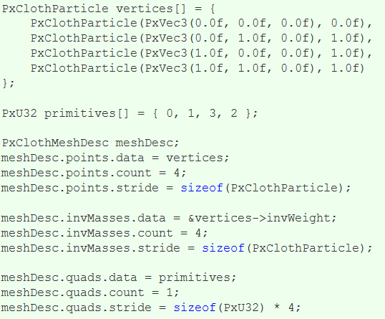
Filling in PxClothMeshDesc
The first task to create a cloth is to fill in the PxClothMeshDesc structure

Slide 5
Each particle is defined by its position in local coordinates and its inverse mass
Setting the inverse mass to zero indicates that the particle is not simulated
Instead, the particle is fixed in local space or kinematically constrained to user specified positions
The inverse mass of simulated particles can normally be set to any fixed positive value.
The PxClothMeshDesc structure allows positions and inverse masses stored in separate arrays or interleaved like in the code above
The mesh can consist of quads or triangles, or both
Notes:
. The cooker prefers quad meshes over triangle meshes when creating constraints and classifying constraint types. The extensions library therefore provides the PxClothMeshQuadifier helper class to extract quads from a triangle mesh.

Slide 6
Creating Fabric
Given the mesh descriptor, a call to PxClothFabricCreate in the extensions library wraps the generation of constraints and the creation of the PxClothFabric structure:
PxClothFabric* fabric = PxClothFabricCreate(physics, meshDesc, PxVec3(0, -1, 0));
The third parameter indicates the direction of gravity, which is used as a hint to determine the direction of 'horizontal' or 'vertical' constraints
The PxClothFabric class describes internal solver data for a cloth
Notes:
. For example, distance constraints consisting of two particle indices and a rest-length are created by the cooker and stored in the fabric data. Multiple cloth instances of the same mesh can share a single fabric instance.

Slide 7
Creating Cloth
A PxCloth object is created using a fabric instance and the initial particle configuration. the cloth instance is simulated as part of a scene:
PxTransform pose = PxTransform(1.0f);
PxCloth* cloth = physics.createCloth(pose, fabric, vertices, PxClothFlags());
scene.addActor(cloth);

Slide 8
Simulation Overview
For one PhysX simulation frame, the cloth solver runs for multiple iterations
The number of iterations is determined by the solver frequency parameter and the simulation frame time
Each iteration integrates particle positions, solves constraints, and performs character and self-collision. Cloth inter-collision is performed once per-frame after all cloth instances in the scene have been stepped forward
Local frame, motion constraints and collision shapes are interpolated per iteration from the per-frame values specified by the user

Slide 9
Particle Integration
A particle state consists of the current position and the position before the last iteration
The size of time step is inversely proportional to the number of solver iterations:
cloth.setSolverFrequency(240.0f);
In general, simulation will become more accurate if higher solver frequency value is used. However, simulation time grows roughly linearly with solver frequency. Typically this value is between 120 and 300.
Notes:
The solver frequency is specified as iterations per second. A solver frequency value of 240 corresponds to 4 iterations per frame at 60 frames per second.

Slide 10
Distance Constraints
One of the most important roles for the cloth solver is to maintain distance between particles so that the cloth does not stretch
This is achieved by applying distance constraints between pairs of particles
The way particles are connected affects how the cloth stretches, compresses, shears, rotates, and bends
PhysX classifies distance constraints into 4 types (see PxClothFabricPhaseType), each of which can be configured with different stiffness parameters.
Note that stretch settings for horizontal and vertical directions are specified separately. This can be used to handle stretching along the gravity (vertical) direction differently

Slide 12
Sometimes it is desirable that distance constraints are not enforced rigorously
The stiffness parameter allows only correcting a portion of the edge length residual per iteration
for example to reduce the strength of bending constraints. A separate, lower stiffness can be used for edges that are only moderately stretched or compressed
For example, a dress can be made to stretch when the character is taking large steps, but still behave correctly during pirouettes

Slide 13
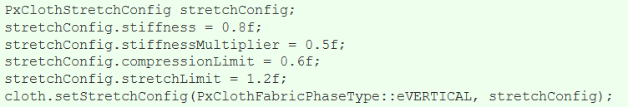
The following code sets up the vertical constraints such that when edges are compressed more than 60% or stretched more than 120%, a stiffness of 0.8 will be used. Otherwise a stiffness of 0.4 = 0.8 * 0.5 will be used:

Slide 14
Cloth Collision
Each cloth object supports collision with spheres, capsules, planes, convexes (groups of planes) and triangles
By default these shapes are all treated separately from the main PhysX rigid body scene
collision against other PxScene actors can be enabled using the PxClothFlag::eSCENE_COLLISION.
Collision shapes are specified in local coordinates for the next frame before simulating the scene
Capsules are defined by a pair of indices into the spheres array and each sphere may have a different radius thus forming a tapered capsule
Spheres can be shared between multiple capsules
Notes:
, which can be useful for modelling characters (upper and lower leg made up from capsules can share the sphere at the knee). Sharing of spheres also makes the simulation more efficient and robust, so is highly encouraged. The following code illustrates how to add two spheres of different radius and create a tapered capsule between them:

Slide 15
Creating Cloth Collision Data
PhysX 3 cloth does not collide with rigid bodies
Instead, each cloth object supports collision with spheres, capsules, planes and convex shapes (groups of planes)
these shapes are all treated separately to the main PhysX rigid body scene.
Sphere and capsule shapes must be specified at cloth construction time

Slide 16
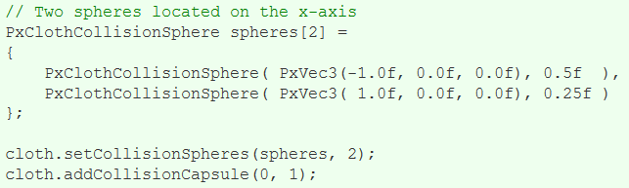
The following code illustrates how to add two spheres of different radius and create a tapered capsule between them:

Slide 17
Planes can be added through PxCloth::addCollisionPlane() method but will not be considered for collision unless they are referenced by a convex shape
Notes:
. For example, the following code shows how to setup a typical upward facing ground plane through the origin:

Slide 18
Continuous Collision Detection
continuous collision detection is supported and can be enabled by calling:
Continuous collision is around 2x more computationally expensive than discrete collision
but it is necessary to detect collision between fast moving objects

Slide 19
Virtual Particles
Virtual particles provide a way of improving cloth collision without increasing the cloth resolution
they only exist during the collision processing stage and do not have their position, velocity or mass explicitly stored like regular particles
they can be thought of as providing additional samples on the collision surface.

Slide 20
example
A virtual particle is defined by 3 particle indices and an index into a weights table, the weights table defines the barycentric coordinates used to create a virtual particle position from a linear combination of the referenced particles
The following is an example weights table that can be used to create a distribution of 4 virtual particles on a triangle:

Slide 21
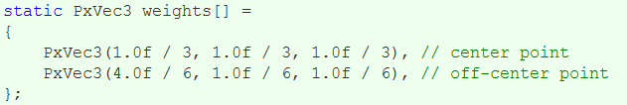

Slide 22
During collision processing each virtual particle is tested for collision like a regular particle and the collision impulse is redistributed back to the original particles using reverse interpolation.

Slide 23
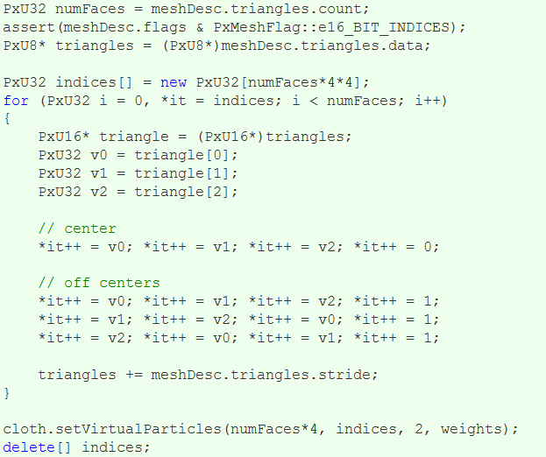
The code below shows an example of how to set up the virtual particles from a PxClothMeshDesc:

Slide 24
Fricton and Mass Scaling
Coloumb friction can be enabled and will be applied for particle and virtual particle collisions by setting a friction coefficient between 0 and 1:
cloth.setFrictionCoefficient(0.5f);
Additionally, there is an option to artificially increase the mass of colliding particles, this temporary increase in mass can help reduce stretching along edges that are being tightly pulled over a collision shape
determined by the relative normal velocity of the particle and collision shape and a user defined coefficient
cloth.setCollisionMassScale(20.0f);

Slide 25
Using GPU Cloth
Cloth can be simulated on a CUDA enabled GPU, by setting the corresponding flag:
When no CUDA capable GPU is available PhysX will issue a warning, and subsequent simulations will be run on CPU.

